Slide 1
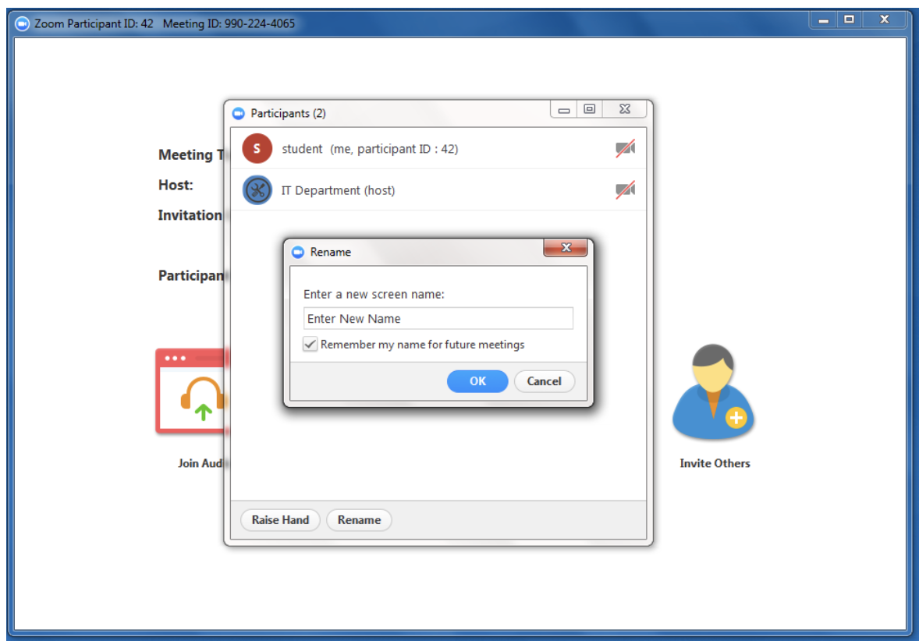
Welcome to the LARC Webinar
Please sign-in in the “Chat Box”, include:
Your Name
Organization
Site/s where you work or coach
Please rename yourself with your actual name or facility name

Slide 2
PAGER
Purpose:
To Improve Care to patients with HIV and other disease states
To embed QI in our DNA
Agenda:
Ice Breaker Poll – Dr. Barbara (Record Meeting)
A Message from the LARC PMT – Fortunate / Japhet
Knowledge Burst – How to Critique a QI Project - Dr. Barbara
Q & A (10 minutes) – Dr. Barbara / Dr. Katy
Ground Rules:
Begin & end on time
Respect for all persons & all thoughts
Encourage engagement & participation
Keep audio on mute unless speaking / Raise hand to share or put question in chat box
Expected Outcomes:
To use the QI Project Evaluation Checklist to provide a critique of a QI Project
To learn how to improve one’s own QI project through critique of other QI projects
Roles:
Host – Dr. Barbara
Facilitator – Dr. Barbara / Dr. Katy

Slide 4
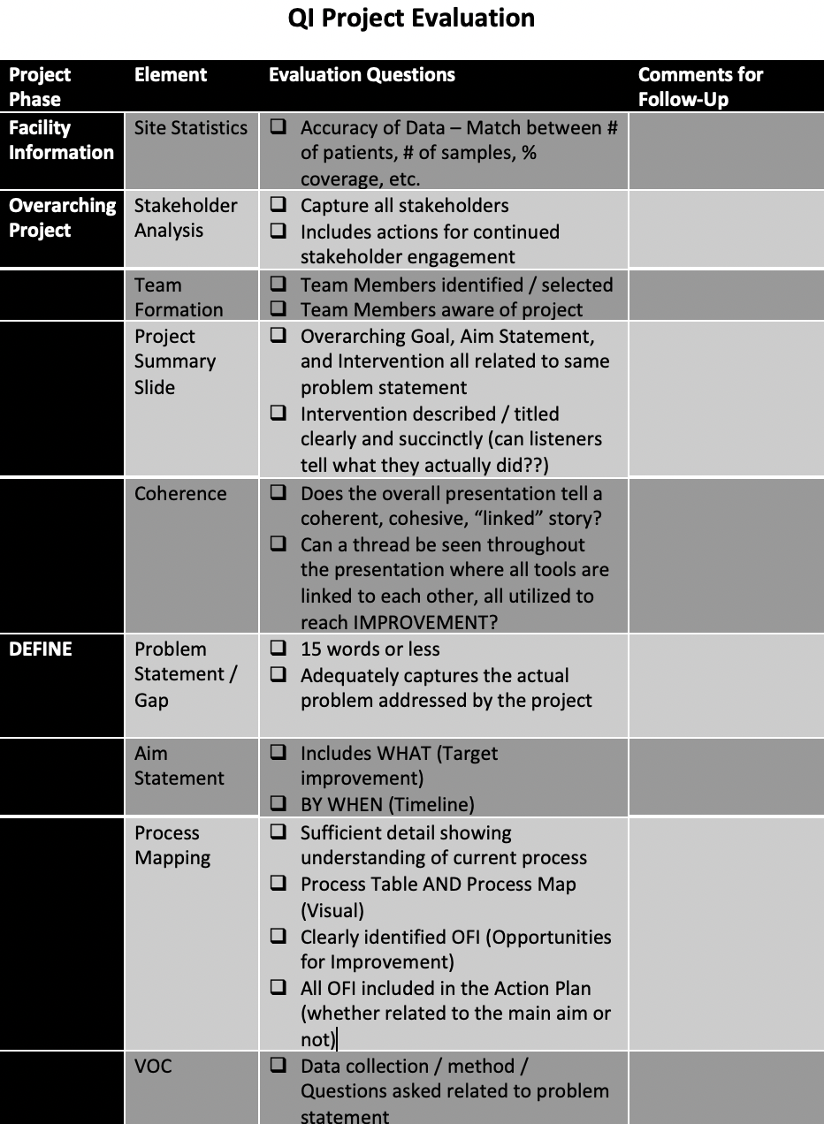
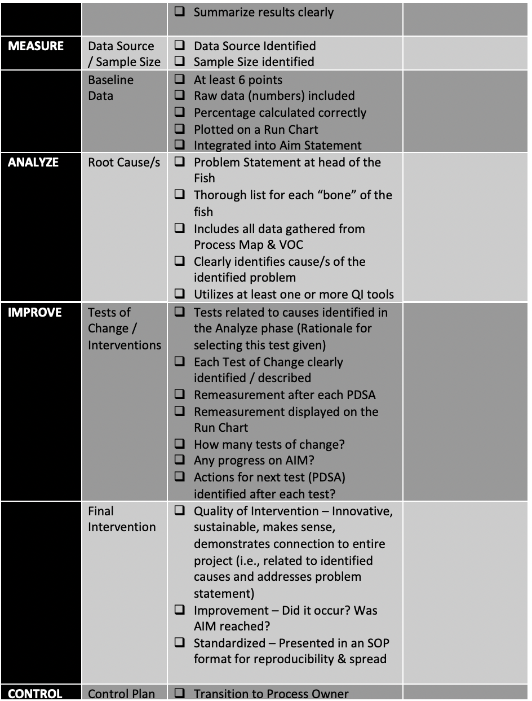
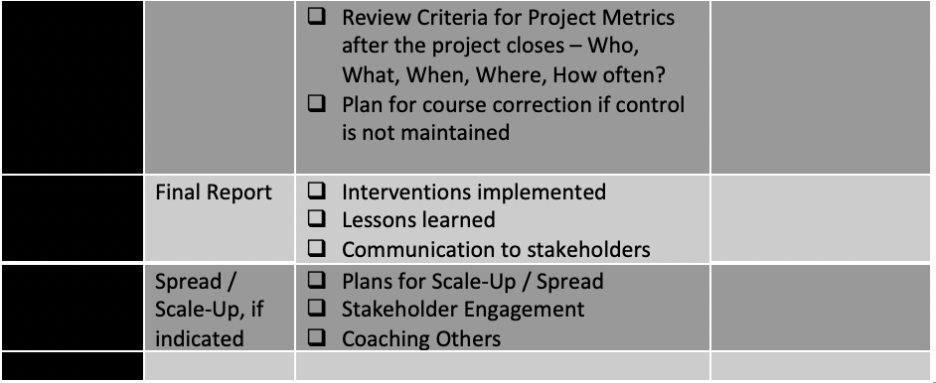
An Evaluation Guide is Born

Slide 5
LARC Webinar
For Today:
How to critique a QI project
29 July 2020
Barbara Chase McKinney, MD, PMH

Slide 6
Wakunda West
Patient Management
January 2020

Slide 7
Kuwadzana Poly Clinic Team
Brief description of the facility
# of patients on ART # 4 800
# patients VL eligible # 1 500
# VL samples collected per month 500 samples
VL Coverage- 67%
VL Suppression Rate-85%

Slide 8
Kuwadzana Poly Clinic
Brief description of the facility
Poly Clinic [City of Harare]
# of patients on ART # 4468
# patients VL eligible form Nov 2019 Jan 2020 : 1056
# VL samples collected during period : 584
Our VL coverage of _584___with an overall suppression rate of :97.5 %
Unsuppressed rate : 2.5 %

Slide 9
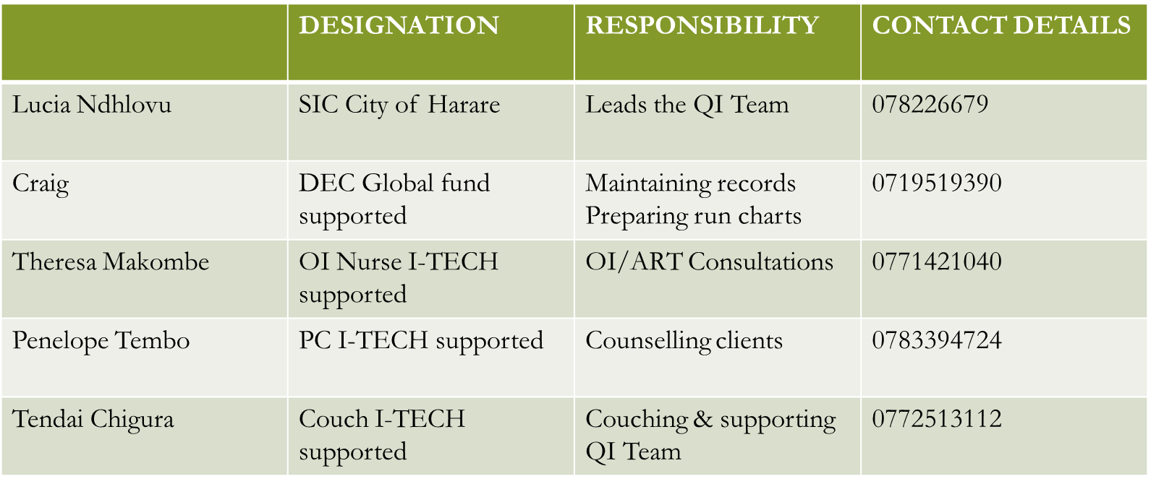
Team

Slide 10
The Story of Our Project
Wakunda has a catchment area that has a OI/ART population 4486 clients active on ART as of December 2019. We offer a wide range of services to the
general populace, ranging from MNCH,PMTCT,HTS,OI/ART
Our aim is to improve the utilization of the Viral Load Test documentation in Patient files In the management of PLHIV.

Slide 11
Project Summary
What are we trying to accomplish? | How will we know if a change is an improvement? | What change will we make that will result in an improvement?
Viral Load result documented in the Patient Care Booklet | AIM Statement Improve VL results documented in the patient care booklet from 16% to 95% by 22 January 2020 Aim Statement To improve High viral load patients cared according to guidelines from 75 % to 98 % by 15 Nov 2020 | Intervention (Describe the key elements of your new process/intervention DO NOT complete until LS #2
Improve Patient Care
according to Guidelines

Slide 12
Elevator Speech
This project is about __VIRAL LOAD_____
We are to improve the proportion of clients with Viral Load result documented in the Patient Care Booklet
It’s important because we are concerned about:
Documented Viral Load test result in the patient care booklet
Monitoring of clients according to set standards and guidelines
Success will be measured by showing improvement in:
_increase VL results documented in the patient care booklet from 16% to 95% by 22 January 2020
Proportion of clients who received VL results and had documented in the patient care booklet and also managed according to the viral load algorithm
What we need from you
Technical support, guidance, stationary, and incentives for the staff.

Slide 14
Process Map: The First Step Towards Improvement

Slide 15
Process mapping
Process | What Happens? | Who is responsible? | Duration | Forms/logs | Opportunity for Improvement
1.Book clients eligible for VL bleeding routinely at M3 visit | Confirm with patient Green booklet about the cohort for patient | OI Nurse | 3mins | Patient booklet | How are missed appointments picked up? Text message client day before
2.VL bleeding test from patient @ M6 | Bleeding clients for VL at M6 ART visit and annual VL. Whole blood in EDTA tube, label, date, time and pt name | OI Nurse PC | 3mins | Filling VL request form. [PC] Entering in VL bleeding register. Entering in pt green file | Multiple entries, opportunity to miss documentation in file
3. Sample transportation | Samples packed in a container with Lab forms attached. Samples processed on site are taken to Lab. Riders collects samples at 11.30am to BRIDH Lab | OI Nurse FLF | 20mins | Lab transmittal register. | LABORATORY STAFF WAS OFF –DUTY

Slide 16
4.Receiving results | Lab staff sends results to Maternity or PC/Nurse aide goes to collect results from Lab. Riders bring VL results to Room 9 sample room. OI Nurse collects VL results from room 9 | Lab Tech OI Nurse | 3hours 5mins | Lab register | Transmission of results to OI clinic
5. Entering of VL results | Results are triaged High VL clients phoned same day Results entered in VL bleeding register Pulling of green files Entering results in green booklets Entering results in EPMS | OI Nurse OI Nurse FLF/CLF FLF/CLF OI Nurse DEC | 20mins 30mins 1hour 45mins Max 3days 2days | VL result slip VL bleeding register EAC register High VL register EPMS | EAC sessions Entering of results in green books
6. Results utilization | Text message send to clients with VL received Clinicians analyze results Suppressed VL clients continue current regimens Or switched to TLD | CLF/FLF OI Nurse Doctor | 10mins 10mins | Pt booklet and green file

Slide 17
7.Patients with high VL | Patient goes to see OI Nurse or PC who phoned them. Escorted to PC who does EAC Sessions Green book collected from box with high VL for 1st EACs 1st EAC session done and supplied for 1 month or continues with their drugs they have. 2nd session done after 1 month with 1-month supply of drugs 3rd EAC session again with 1 month supply booked for repeat VL | FLF/CLF PC PC DEC | 5mins 2mins 3mins 45mins | EAC register Pt green book Pt OPD booklets High VL booklet EPMS | EAC sessions appointments Use of high VL form EAC sessions
8.Patient management per Guidelines | Repeat VL done after 3 months If VL remains high, book pts for DR to see on Thursdays to decide for switching | OI Nurse Dr | 5mins | Lab request form for VL Pt green book Pt OPD booklet VL register | Missing opportunities on time of bleeding the repeat VL
9.Patient management continues | Repeat VL post 3months post switching If suppressed continue management and maintain cohorting system for annual VLs | OI Nurse

Slide 18
Gap (Problem Statement):
Documentation of Viral load results in the Patient Care Booklet and EAC register .
Dispensing Practices by clinicians as some are not sticking to set standards.
Changing of staff in the OI Department .

Slide 19
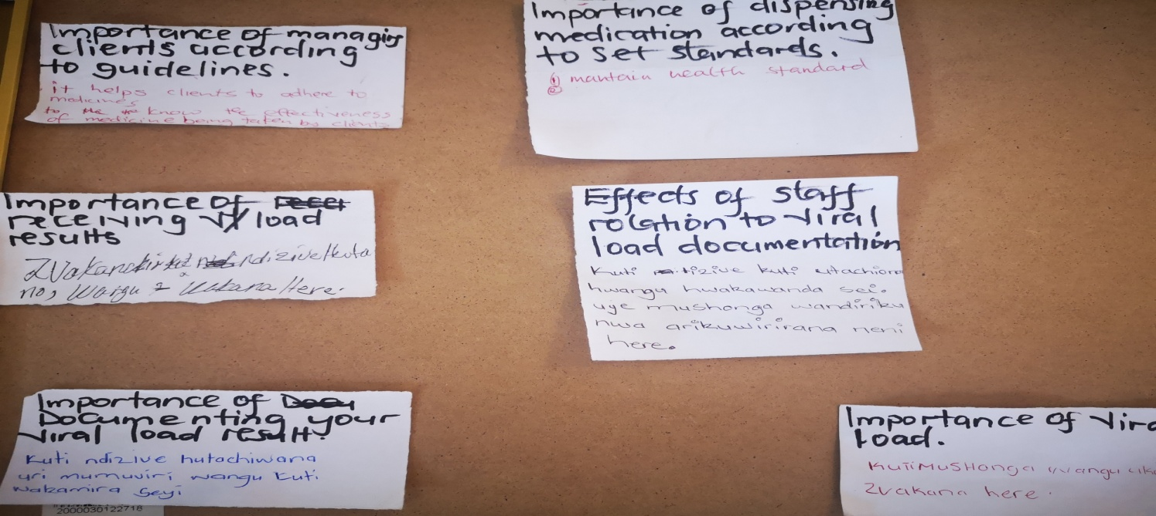
What did you learn? How did you apply what you learned in your intervention?
Lessons Learnt :
Patients are well concerned about the importance of viral load test .
We should monitor our patients as per the guidelines as our clients are keen to know what is going on in terms of their health.
Implementation
Updating clients on their viral load next due date when visit for refills and clinical reviews
Calling the clients when the facility receives their results ,upon visit the clinical staff takes time explaining the meaning of the results ,what they are expected to do and when they are due for next
viral load sample collection .
Voice of Customer (VOC)
Patient
Focus group
Random sampling of customer needs
Results ** see display)

Slide 20
VOICE OF THE CUSTOMER
Analyzed 16 forms
Knowledge of VL 9/16 well versed.
6 month VL -12/16
3/16 were called to clinic to get VL results < 1000c/ml
Areas to improve
Improve timely issuing of results-3/16
Increase staff in OI Department -2/16
Supply 6 monthly ARVs-1/16
VL must be collected anytime of the day- 1/16
9 did not commend on the question

Slide 21
MEASURE
Metric Selected
Numerator
Total number of clients who had viral load results received and documented in the patient care booklet (Total 75)
Denominator
Total number of viral load results received at the facility and were supposed to be documented in the Patient Care booklet (Total 75)
Baseline Data
100% (15 %clients) with received and documented results in the patient care booklet

Slide 22
Data Collection Process
Data Collection Tool
Data collection tool used; Green Books, EAC register, VL bleeding register
Data Collection Plan
Data was collected from the viral load register with a random selection of 25 clients from
Data was collected for a period of 2 hours
Populate a raw Data Table
Data Analysis
16 percent of our clients who had a viral load test done had no test results documented in the patient care booklet and also 45 percent of the eligible population did not have the viral load test done at month 6 as presented by the data collected .
As far as the patient management is concerned we need to act on the issue of documentation across the cascade as it has a negative impact in decision making ,Patient care and treatment according to set standards.
Graphs.

Slide 23
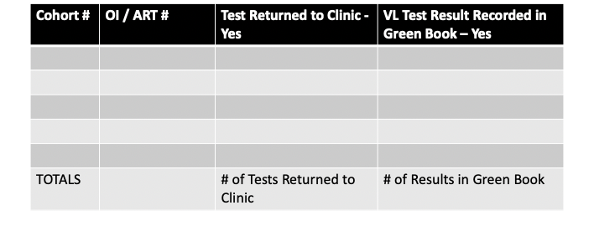
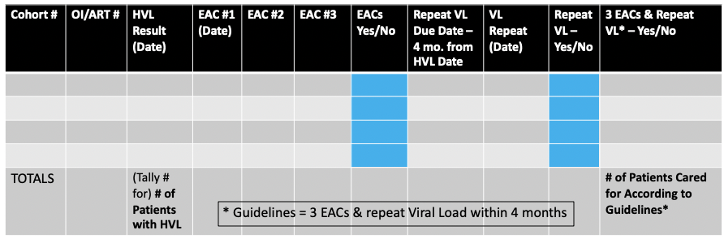
Data Collection Tools - Examples

Slide 24
BASELINE DATA
MONTH | VL RESULTS RECEIVED | VL RESULTS FILED
OCTOBER 2018 | 25 | 5
NOVEMBER 2018 | 25 | 4
DECEMBER 2018 | 25 | 6
JANUARY 2019 | 25 | 3
FEBRUARY 2019 | 25 | 3
MARCH 2019 | 25 | 2
TOTALS | 150 | 23

Slide 25
ANALYZE
1.No standard registers to capture essential
Viral load data
2.Erratic supply of Viral Load request forms
And the high viral load form is too complex
but not essential when reporting and tracking
High viral load monitoring
1.Nurse and patient ratio
2.Motivation /Apathy
3.Lack of on job training
1.Too many registers to be filled
1.Shortage of working space that maintains confidentiality and privacy
2.Electricity availability and erratic power backup
1.Some of the procedures
are time consuming eg from sample collection to result receiving
1.Too long procedures within our e-systems

Slide 26
IMPROVE
IMPACT / EFFORT GRID A Tool for Prioritizing Opportunities
Projects - Detailed planning and work
Just Do It
Change of staff
Documentation throughout the whole
cascade (across all registers and relevant
books.
Dispensing practices and appointment system
Lab Results Mixed with other clinics
Apathy and shortage of clinical staff
Lab wrongly capturing the demographic details of the client….it’s difficult to locate the client on the facility Viral Load sample collection register
Major
Improvement
IMPACT
Workload
Minor
Improvement
Just Do It if Impactful
Maybe some day
OSDM
EHR System
GUIDELINES
Easy to Do
Difficult to Do
EFFORT

Slide 27
Improvements
Documenting results in the improvised register
Call clients with high VL same day we receive results
Filing the results on day received
Documenting date results received
Tracking of clients on EACs

Slide 28
IMPROVE
Small Test of Change (PDSA #1) – Change Tested, Dates Tested
ACT
Based on results from the analysis we agreed as a team to adopt the intervention
PLAN
Document VL results upon receipt in the Sample Collection Register ,Patient Care Booklet ,EAC register
DO
Date Implemented :01 Nov2019 to 22 Jan 2020
STUDY
1.Random sampled 25 records from results received in the month of November 2019 ,December 2019 and January 2020
Triage results on receipt .
Enter into the VL collection book and insert cohort on the VL result copy for easy file location
Pull patient care booklet and document the result on the VL column ,then file result awaiting to be issued to client
If VL result is High document the result in the EAC register for monitoring .Contact the client upon receipt ,Pull the patient care booklet and flag with red sticker ,file on the High VL section
Results shows great improvement from 16 percent to 100 percent
Date Implemented :01 Nov 2019
Date Implemented : 15 Jan 2020
Date Implemented ; 22 January 2020
Project Adopted as a change intervention
Notes:
28
28

Slide 29
Aim No 1 Increase Proportion of VL Test Results recorded in Patients' record (Green Book) from 16% to 95% by 22 Jan 2020
Numerator = #of VL Test results entered into GB
Denominator = Total Test result received by the Facility
Month | VL results received | VL results recorded
Nov 2019 | 25 | 25
Dec 2019 | 25 | 25
Jan 2020 | 25 | 25
TOTALS | 75 | 75

Slide 31
Baseline = average of the 6 months’ percentage = 15% or 14% (median)

Slide 32
AIM 1 Baseline and post baseline performance

Slide 33
IMPROVE
Small Test of Change (PDSA #2) - Change Tested, Dates Tested
ACT
The intervention was adopted with great conviction as the results were so outstanding
PLAN
Document High VL result in the EAC for high viral load monitoring ,Call client on the date of result receipt, document the result in the patient care booklet, Flag the patient care booklet with a red sticker, file separately on the high VL section.
DO
Conducted the first EAC on the day of receipt, Second EAC conducted 1 month from the date of first EAC ,receipt, third EAC conducted 1 month from the date of Second EAC, Repeat (Second) VL done a month after the third EAC
STUDY
Collect the data of all VL results received and do a comparison with the data abstracted from the EAC register giving a close attention to clients who did complete the EAC’s and had a repeat VL collected ,received results, issued and switched to second line regimen or maintained first line regimen or have EAC’s repeated (Analyze the patient final outcome )
If client missed EAC session ;counselors would contact the client for follow up
Upon receipt of repeat VL result the client is contacted on the same day ,result documented in all relevant books including the date of receipt, Clinician would analyses the result if its suppressed the client would continue with 1st line regimen, If high recommend for possible switch or would switch if there are no complications .If result is showing improvement we would recommence on EAC’s
If patient contact number is unreachable document in the tracking register for follow-up
Notes:
33
33

Slide 34
Aim No 2 Increase Proportion of High Viral Load (HVL) patients cared for according to guidelines from 75% to 95% by June 2020
Numerator = #of HVL patients cared for according to guidelines
Denominator = # of patients with high VL
Month | Patients with HVL | HVL patients managed as per guidelines | Clients with Final Outcomes after EAC completion
OCT 2019 | 16 | 16 | 14
NOV 2019 | 23 | 17 | 10
DEC 2019 | 19 | 19 | 0
JAN 2020 | 45 | 18 | 0 (Contact Numbers not reachable)
TOTALS | 103 | 70

Slide 35
Aim #2 – Outcome Increase proportion of High Viral Load (HVL) Patients cared for according to guidelines from _________ to __________ by 15 November 2020.
Numerator = # of HVL Patients Cared for According to Guidelines*
Denominator = # Patients with High Viral Load
Cohort # | OI/ART # | HVL Result (Date) | EAC #1 (Date) | EAC #2 | EAC #3 | EACs Yes/No | Repeat VL Due Date – 4 mo. from HVL Date | VL Repeat (Date) | Repeat VL – Yes/No | 3 EACs & Repeat VL* – Yes/No
TOTALS |  | (Tally # for) # of Patients with HVL |  |  |  |  |  |  |  | # of Patients Cared for According to Guidelines*
* Guidelines = 3 EACs & repeat Viral Load within 4 months

Slide 37
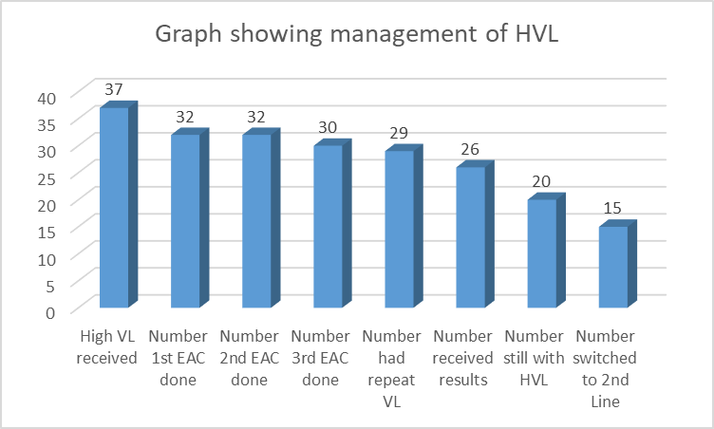
AIM 2: Improve patient care According to Guidelines.
Number of High VL | Numberhad EAC 1 | Number had EAC 2 | Number had EAC 3 | Number had Repeat VL | Num received results | Number of Repeat VL results | Num suppressed VL | Num switched to 2nd Line | Others * See Notes
37 | 32 | 32 | 30 | 29 | 26 | 20 | 2 | 15 | 15
 | 86% | 86% | 81% | 78% | 70% | 54% | 5% | 41% | 41%
Notes:
Others include 4 clients who were recommended for switching, 4 LTFU, 3 transfer out, 2 died and 2 awaiting Repeat VL results.

Slide 39
Aim No 3 Increase Proportion of eligible patients who have VL done in the past 12 months from 29% to 95% by June 2020
Numerator = # of Viral Load results recorded in patient record
Denominator = # of patients eligible for Viral Load Test
Month | VL results recorded in patient record | Patients eligible for VL Test
Nov 2019
Dec 2019
Jan 2019
TOTALS

Slide 40
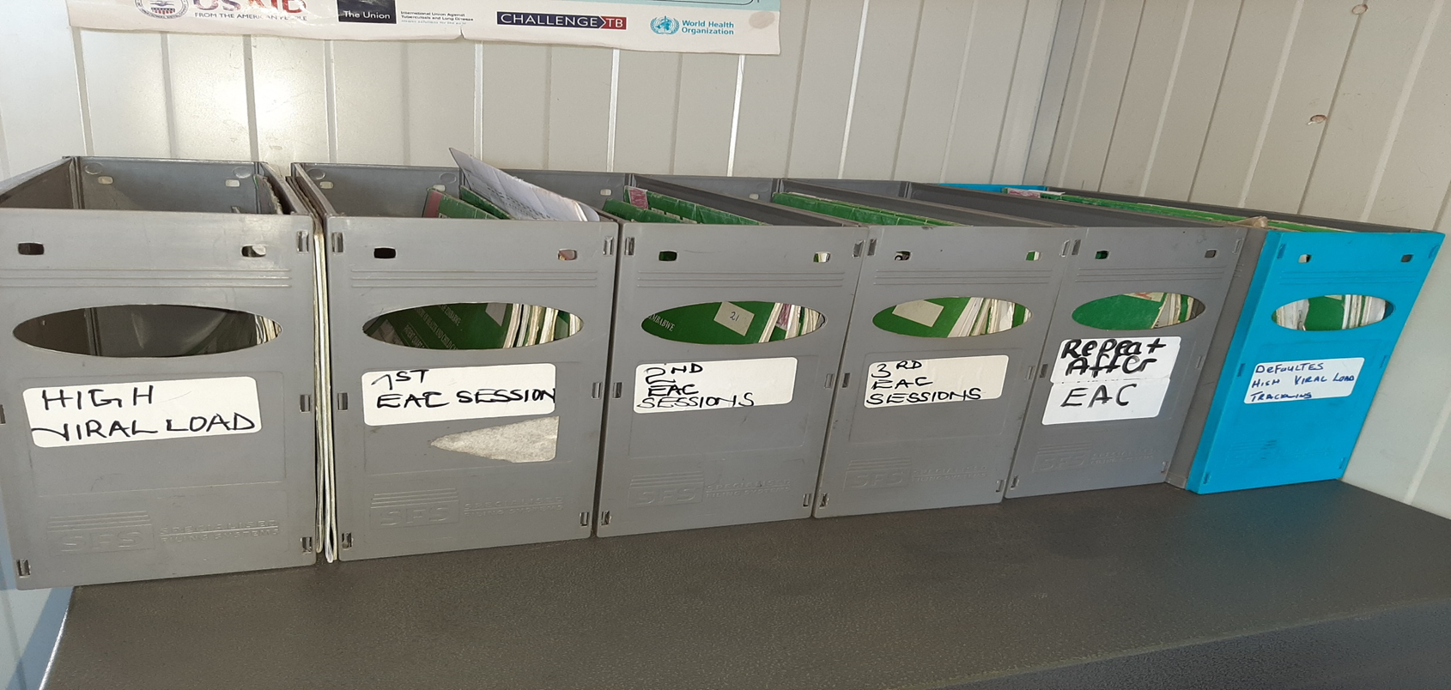
JUST DO IT

Slide 41
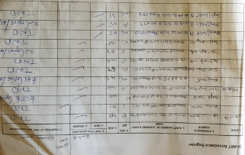
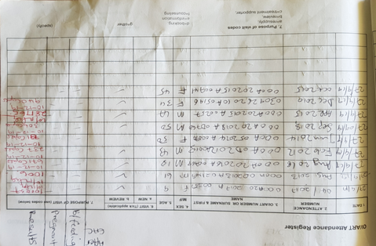
IMPROVE
5S - BEFORE
5S - AFTER
Number of Samples Collected # 9
Number of results received and properly documented in the
Collection register #8
Filled results in the patient care booklet # 8
Results were received but no documented date of results receiving
Notes:
41
41

Slide 42
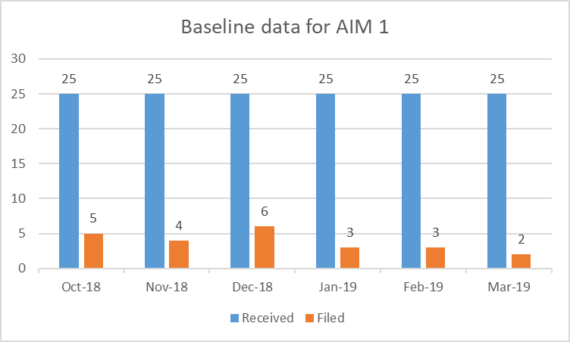
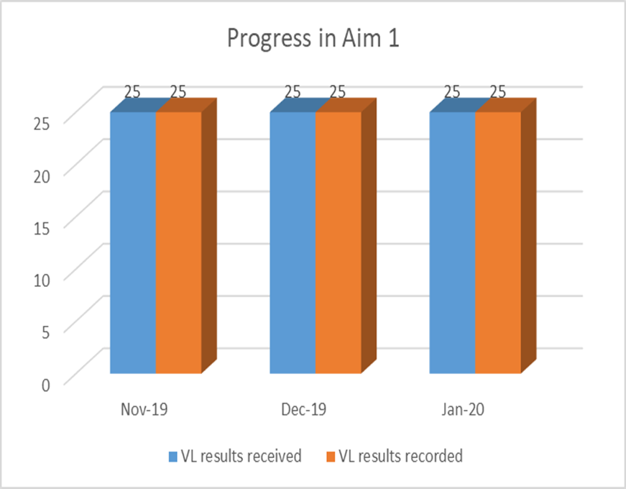
IMPROVE
5S - BEFORE
5S - AFTER
VL results received and documented
VL results received and documented
Notes:
42
42

Slide 43
IMPROVE
Intervention – Standard Work
What did you do to solve your problem?
Discussed the importance of improving documentation.
Give an overview of your intervention.
Tasked one RGN to enter results in VL bleeding register and write the cohort number on the hard copy at receipt of VL results.
Task shifted the work to a PC to cover during her absence.
assisted by CLF
Show your Standard Work
Notes:
43
43

Slide 44
CONTROL
Indicate to whom or what group that you have shared your presentation Shared presentation with OI Team
Indicate any scale-up that has been done
Scaling up of VL bleeding and filing

Slide 45
Challenges
Share challenges; What did the team do to address the challenges?
Challenges
Address challenges
No enough time for Couch to support the facility Team due to competing events.
Facility Team failing to regularly meet due to off duties and the duties for the SIC.
No teas nor drinks for the Team members when they meet with the Couch
The coach resorted to communicating with Team more through phoning and on WhatsApp platform.
At times Facility Team working while 3 when SIC is tied up and only share with her their progress.
No solution as yet.
Team referring their questions to Liberty who is very helpful.

Slide 46
Lessons Learned
Correct and consistent documentation is a tool that can lead to great improvement as shown by our data
If clients are managed according to guidelines and set standards we can achieve high viral suppression and it improves quality of care that we offer as a facility.
If clients are managed according to the cohorting system it’s a good change intervention that can lead to improvement rather than using a random selection approach.
Using a collaborative approach in the management of viral load is essential for improvement and it can then enhance quality of patient care .

Slide 47
Way Forward…
To work tirelessly as a Team in avoiding missing eligible clients for VL annually for general population and every 6 months for PMTCT mothers.
Ensure drug prescription meets the VL bleeding month(making use of App diary)
To continue proper documentation of patients bled for VL and results in VL bleeding register, patient green book, EAC register for high VL and patient OPD card.
Management of high VL must be as per algorithm, repeat VL after 3 months of good adherence for general populace and 1 month for PMTCT mothers.

Slide 48
Action Plan
TOPIC/GOALS | ACTION ITEM | BY WHOM? | BY WHEN?
Action Plan – Create / update the action plan following each learning session

Slide 49
Project Deliverables
On-Site / Session 1
DEFINE / MEASURE / ANALYZE
Session 2
IMPROVE
Session 3
CONTROL
Identify Stakeholders
Team Formation
Map the Process (Current)
ID / Prioritize Opportunities
Project Outline
Baseline Metrics - Data Collection Tool/Plan
Action Plan
Elevator Speech
VOC Information
Root Cause Analysis
1 Rapid/Small Test of Change (PDSA)
Presentation
Update Project Outline, if necessary
1 5S Exercise
1 Visual Management Application
2 or more Tests of Change (PDSA)
Select and Implement Change
Modify Solution(s) where necessary by additional Test of Change (PDSA)
Create Future State Map
Standard Work
Presentation
Update Project Outline, if necessary
Validate Solution(s) / Interventions
Create Control Plan
Transfer to Operational Owner
Share/Spread Intervention, if applicable
Final Presentation
Project Champion
Notes:
Just in Time training to accomplish deliverables

