Slide 1
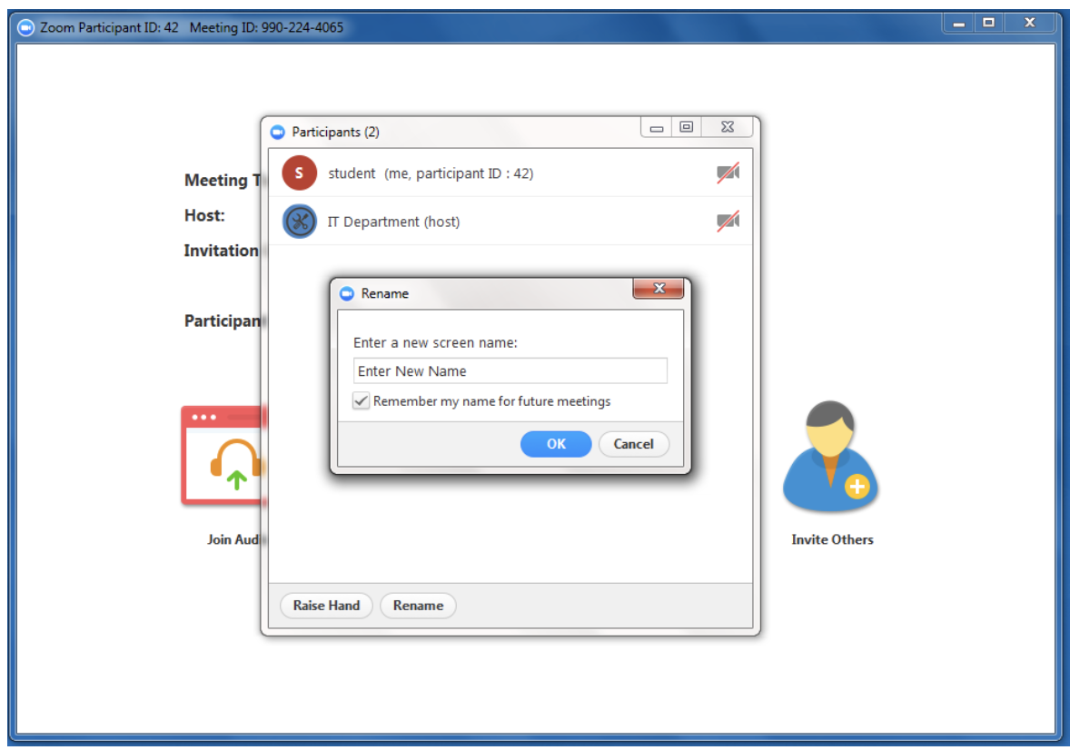
Welcome to the LARC Webinar
Please sign-in in the “Chat Box”, include:
Your Name
Organization
Site/s where you work or coach
Please rename yourself with your actual name or facility name

Slide 2
PAGER
Purpose:
To show how QI can be utilized in our routine work lives
To provide a guided approach to QI Initiative Aim #3 – Viral Load Coverage
Agenda:
Welcome / Introductions / PDSA / Poll (10 min) – Dr. Barbara (Record Meeting)
Special Guest – How to Apply QI Tools to an Everyday Work “Opportunity” (10 minutes) - Romana
A Message from the LARC PMT Leadership (10 min) – Dr. Khabo
Aim #3 – Coverage: DEFINE/MEASURE/ANALYZE (45 min) – Dr. Barbara / Dr. Katy / Dr. Khabo / Japhet
Q & A 15 min
Ground Rules:
Begin & end on time, Respect for all persons & all thoughts, Encourage engagement & participation, Keep audio on mute unless speaking / Raise hand to share or put question in chat box
Expected Outcomes:
To use QI tools to address everyday work “opportunities”
Complete deliverables due August 19: To collect baseline data on Aim #3 and complete the problem statement
Roles:
Host – Dr. Barbara, Facilitator – Dr. Barbara / Dr. Katy, Special Guest – Romana Rugare Katekwe

Slide 3
Introductions

Slide 5
Introductions

Slide 6
Request: Include Introductions in the LARC Webinars
Why not make it a PDSA?

Slide 7
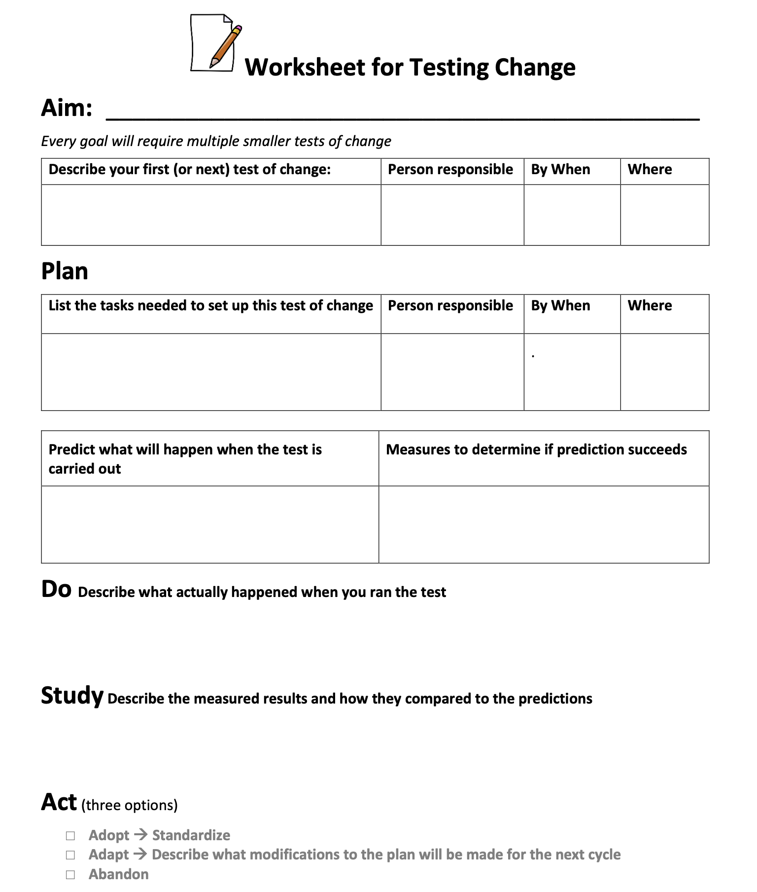
There’s a tool for that!
Workbook, p. 12

Slide 8
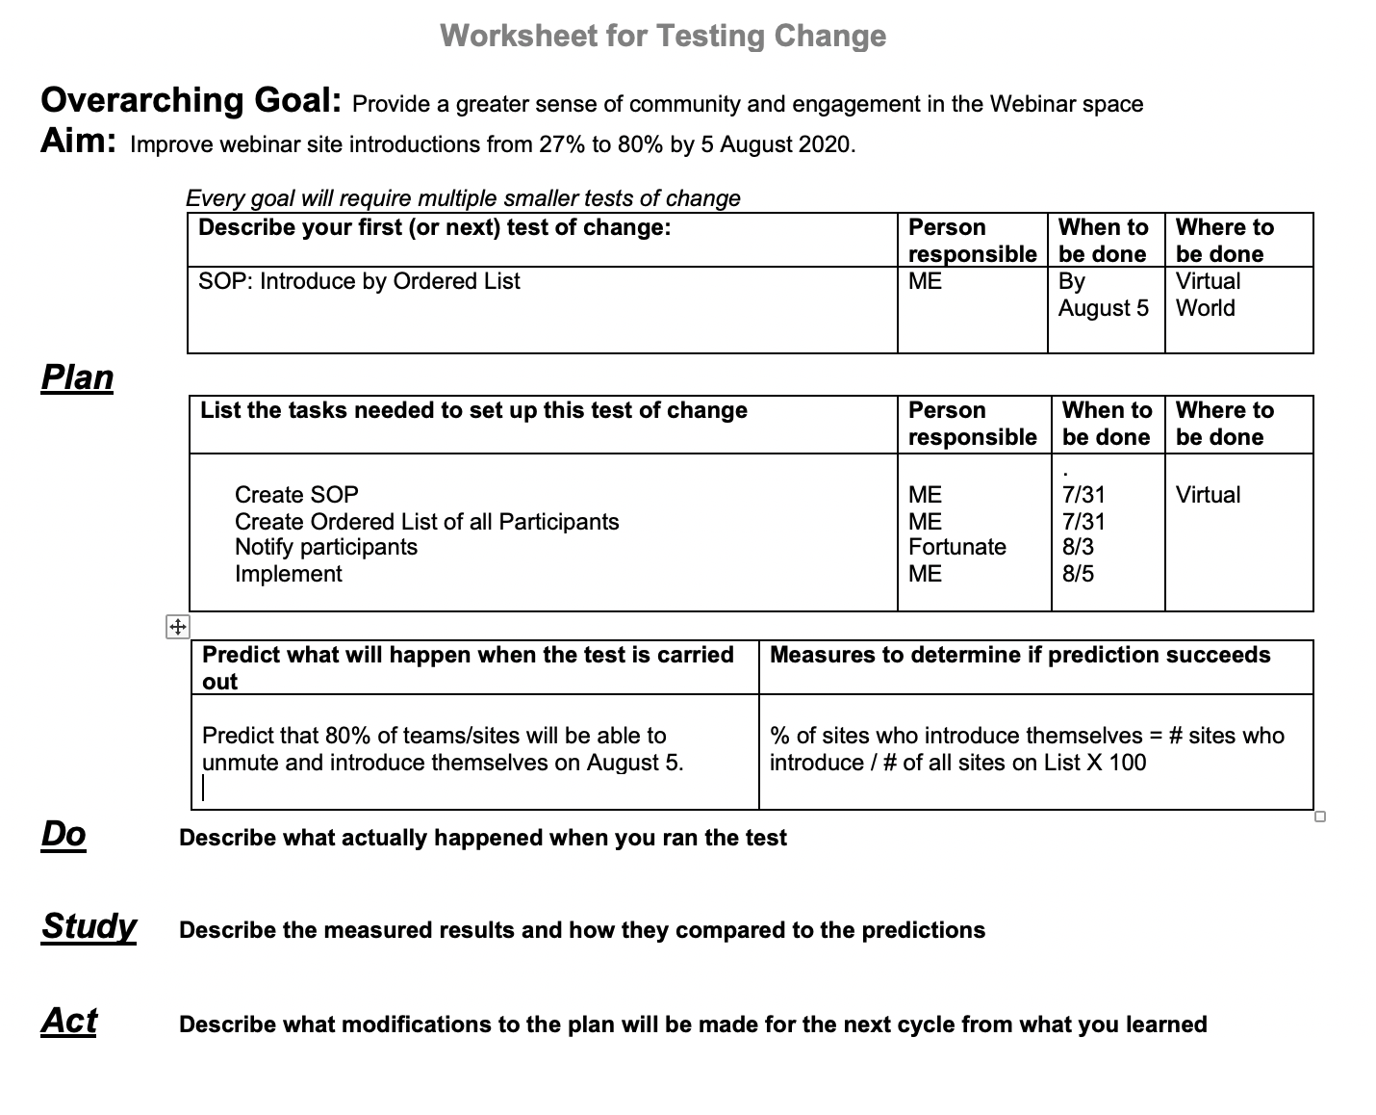

Slide 9
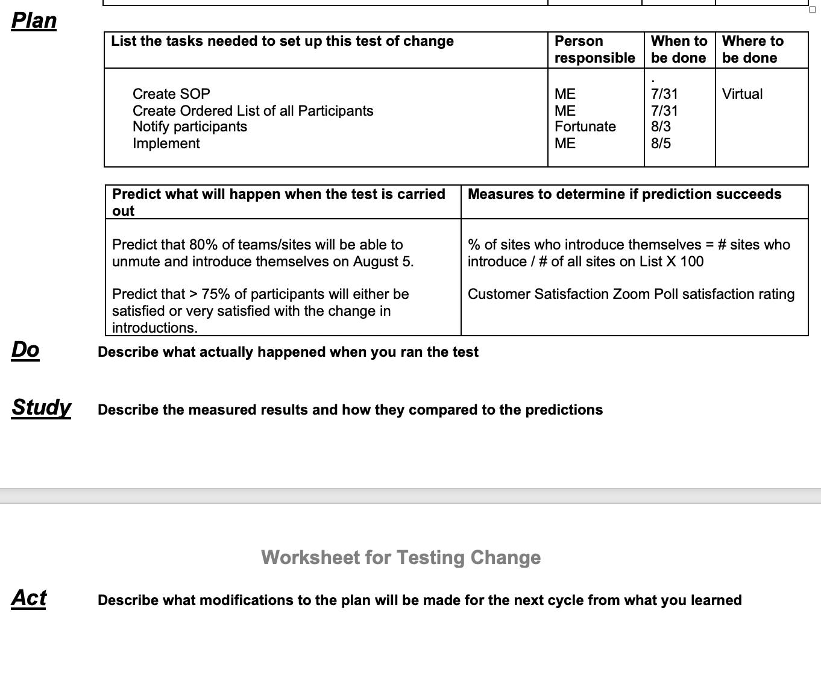

Slide 10
Using QI in your Routine Work Life
Romana Rugare Katekwe |
Quality Improvement Officer
ZIMTTECH

Slide 11
Q & A for Romana
Notes:
How is using data to make decisions helpful in your routine work life? Could you contrast the manager/leader who makes decisions using data versus the manager/leader who uses their own knowledge (combined with authority) to make changes?
As a leader, how does setting up a “mini” QI project save you time, at the end of the day?
What about “root cause analysis”, what did you learn that guided your intervention? Which tool did you use?

Slide 12
DATA: Moving from Raw Data → Analyzed Data → Visible Data

Slide 13
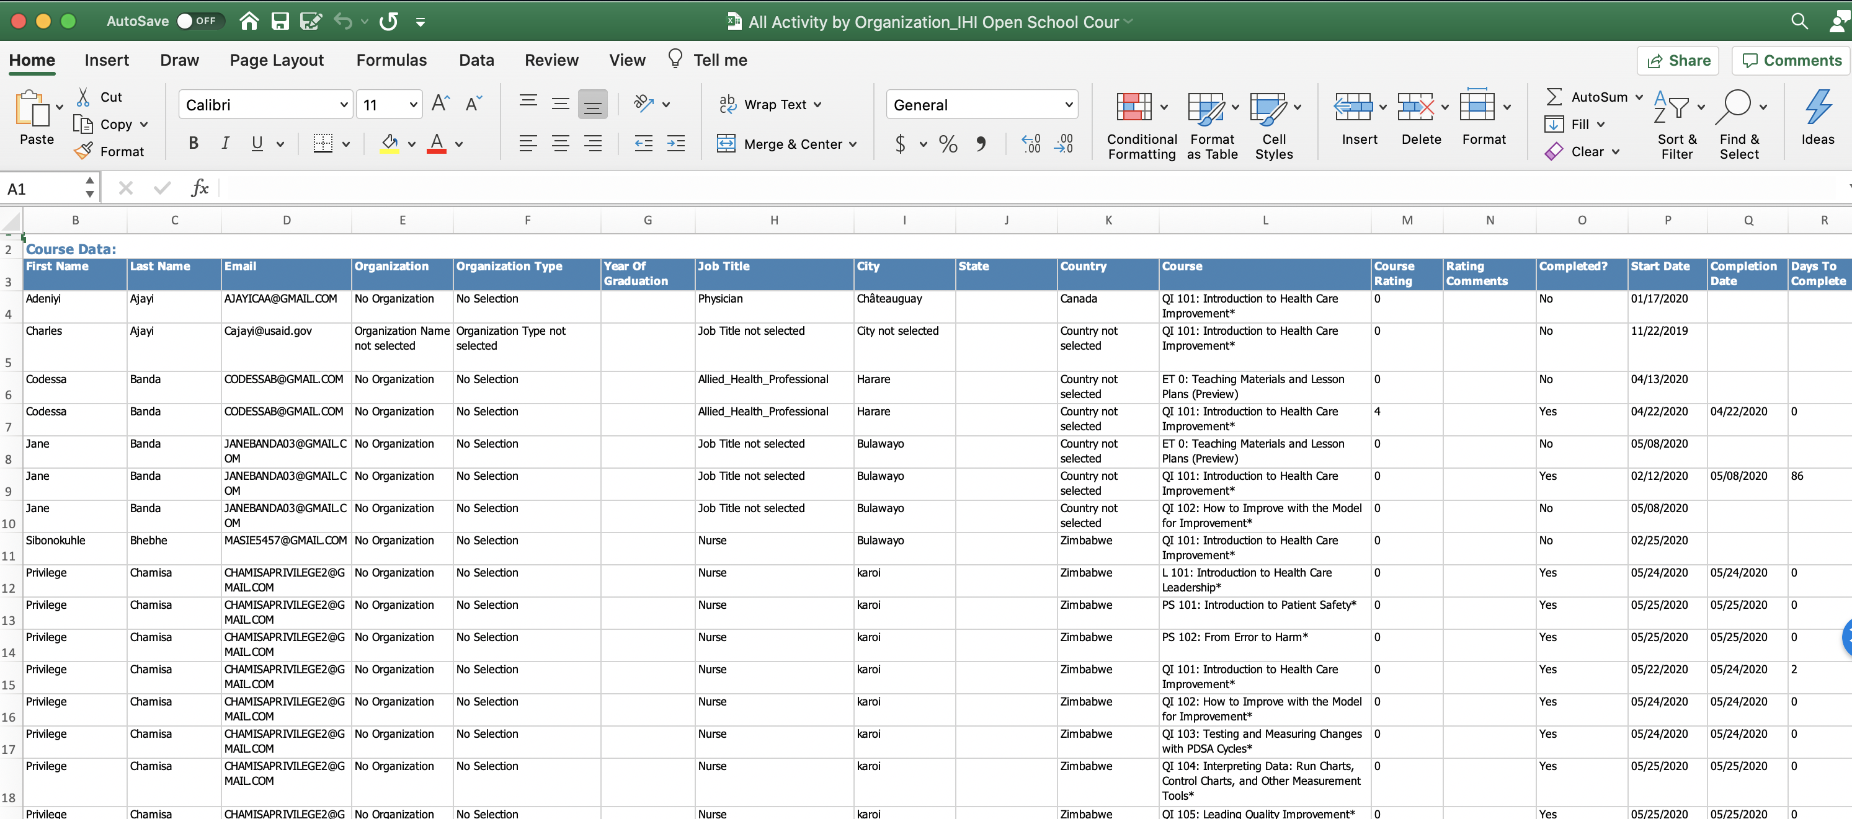
Raw Data

Slide 14
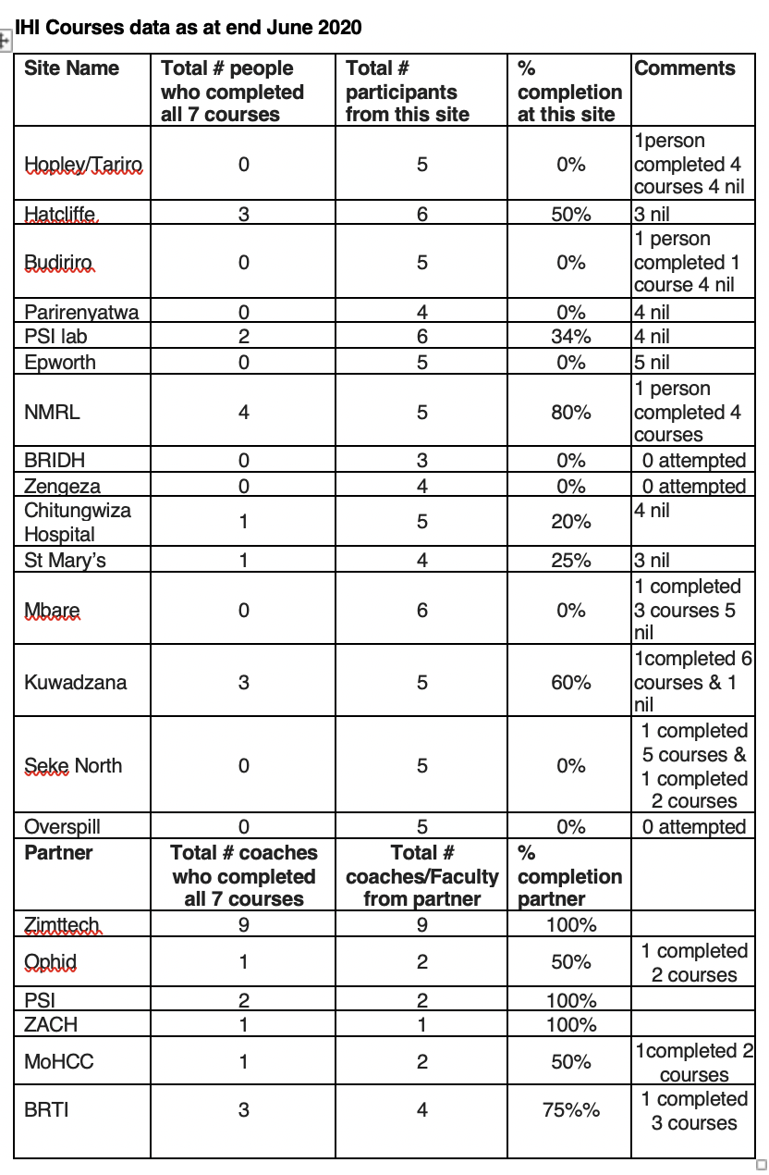
Data
Analyzed

Slide 15
Data Made Visible

Slide 16
Data Made Visible

Slide 17
And now a word from Dr. Khabo

Slide 18
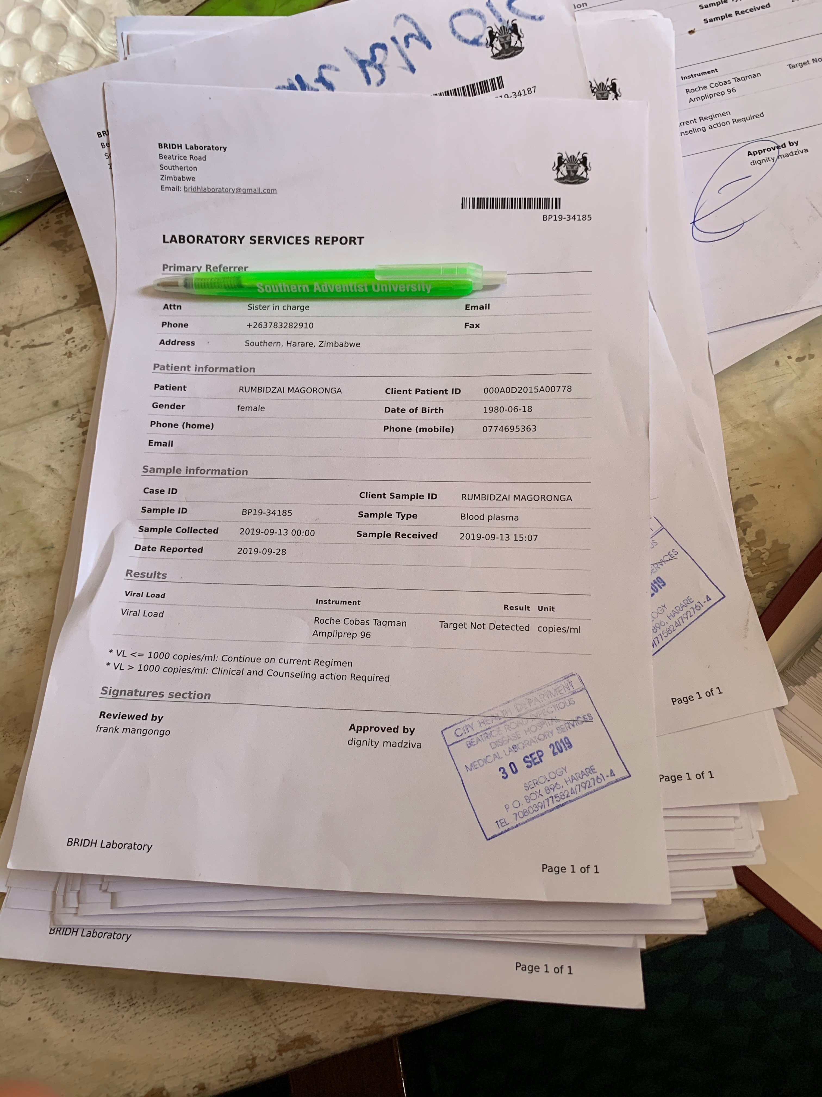
Aim #3: Improve Viral Load Coverage
Viral Load Test Result

Slide 19
The Outcome: A Completed Quality Improvement Project

Slide 20
Project Summary
What are we trying to accomplish? | How will we know if a change is an improvement? | What change will we make that will result in an improvement?
Overarching Goal Improve Viral Load Coverage | AIM Statement Increase proportion of Eligible Patients with a Viral Load Test completed* from _________ to __________ by 15 November 2020. * - Results Recorded = # of Viral Load Results recorded in Patient Record # of Patients Eligible for a Viral Load Test | Intervention

Slide 21
Remember: DMAIC
Define
Measure
Analyze
Improve
Control

Slide 22
Remember: DMAIC
DATES NEED TO BE UPDATED
AUG 19 –
SEPT 14
SEPT 16 -
NOV 16
Define
Measure
Analyze
Improve
Control
AUG 5 - 19

Slide 23
DEFINE
Problem Statement / AIM
MEASURE
Baseline Measure / AIM
ANALYZE
Root Cause
IMPROVE
CONTROL
Change = Intervention = Solution
Sustainable
Improvement

Slide 24
LARC Schedule… Aim #3
Session # | Date | Topics to cover | Deliverables
DEFINE / MEASURE / ANALYZE | Aug 5 | Problem Statement Process Map – Updated COVID VOC Baseline Data Collection Root Cause Analysis
ANALYZE / IMPROVE | AUG 19 | Data Collection – After Improvement Linking Root Cause Analysis & VOC to PDSA How to Improve a Process PDSA – Changes provided for teams to test | Problem Statement Updated Process Map VOC Baseline Data Root Cause Analysis
IMPROVE | AUG 26 | PDSA – Moving beyond “1” 5S | Data Collection Log PDSA
IMPROVE | SEPT 2 | Data Analysis Standard Work | PDSA 5S
LS #3 IMPROVE / CONTROL | SEPT 14-16 | Case Presentations Standard Work / Change Packages DMAIC CONTROL Phase– Tools / Activities | PDSA Refined
IMPROVE | SEPT 30 | PDSA Future State Process Map | PDSA Refined / Develop Standard Work
IMPROVE / CONTROL | OCT 7 & 21 | PDSA → Standard Work Control Plan | Future State Process Map Standard Work / Change Package Control Plan
DATES NEED TO BE UPDATED

Slide 25
DEFINE
MEASURE
ANALYZE

Slide 26
“If I had an hour to solve a problem… I'd spend 55 minutes thinking about the problem and five minutes thinking about solutions.”
Albert Einstein

Slide 27
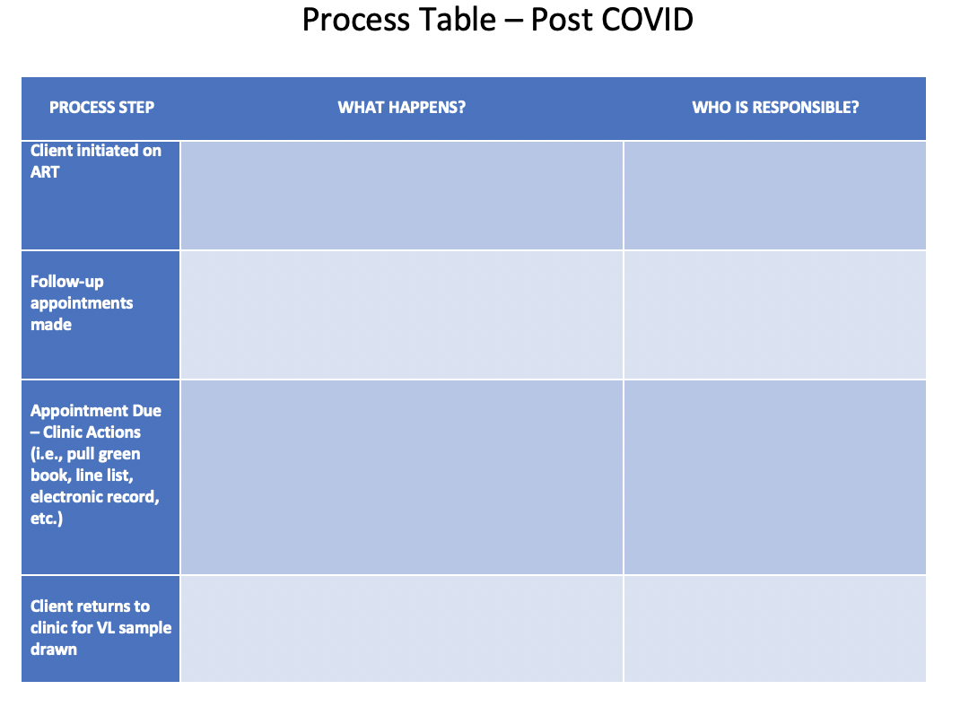
Process Mapping

Slide 28
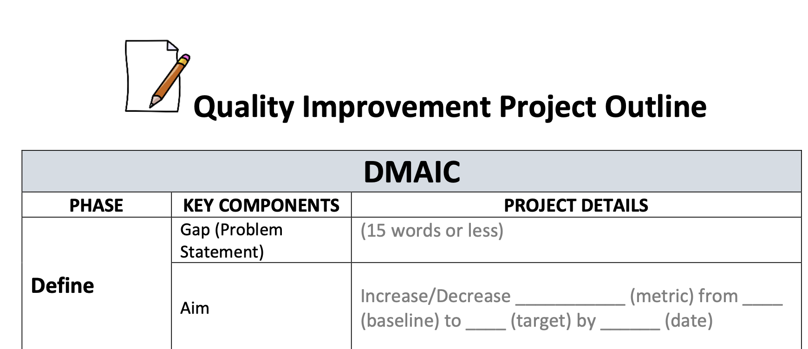
Problem Statement: 15 Words
Workbook, p. 14

Slide 29
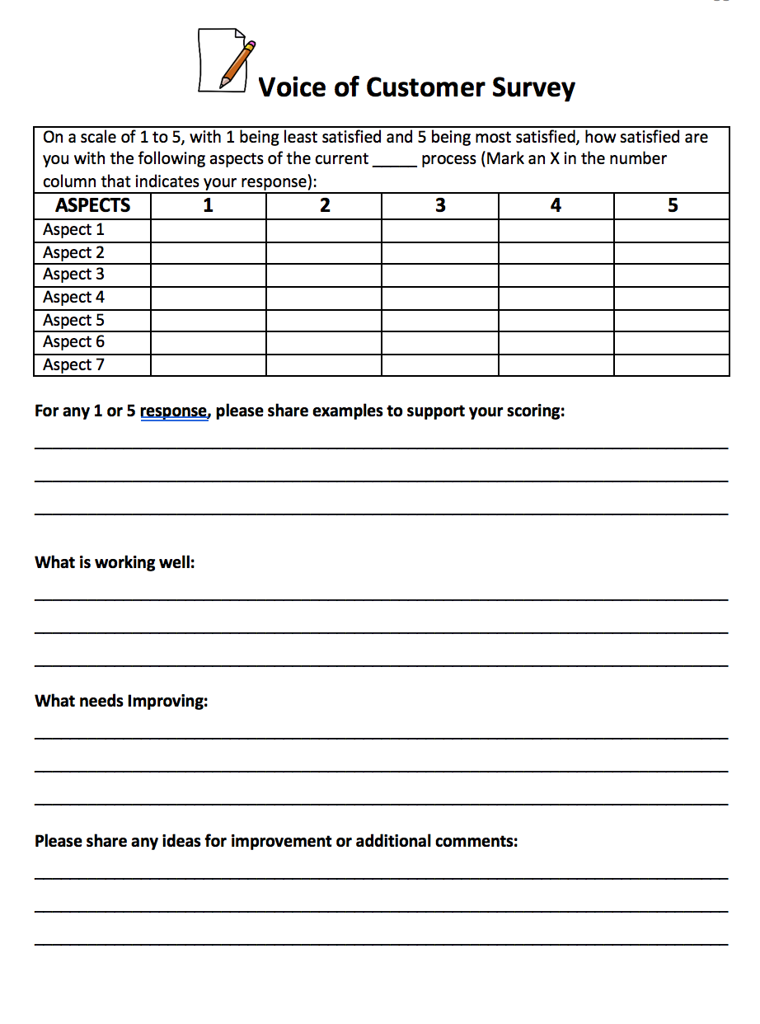
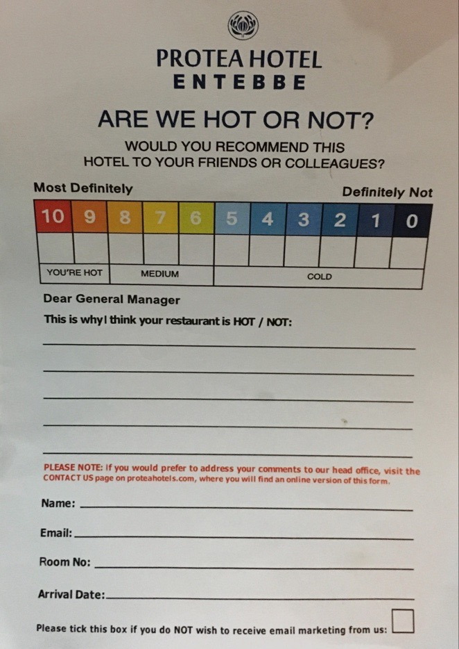
Voice of the Customer
Workbook, p. 43-45

Slide 30
DEFINE
MEASURE
ANALYZE

Slide 31
Baseline Data Measurement
= # of Viral Load Results recorded in Patient Record
# of Patients Eligible for a Viral Load Test

Slide 32
Data Collection: After Improvement
DATA CAPTURE LOG

Slide 33
Data Collection: After Improvement
DATA SUMMARY

Slide 34
DEFINE
MEASURE
ANALYZE

Slide 35
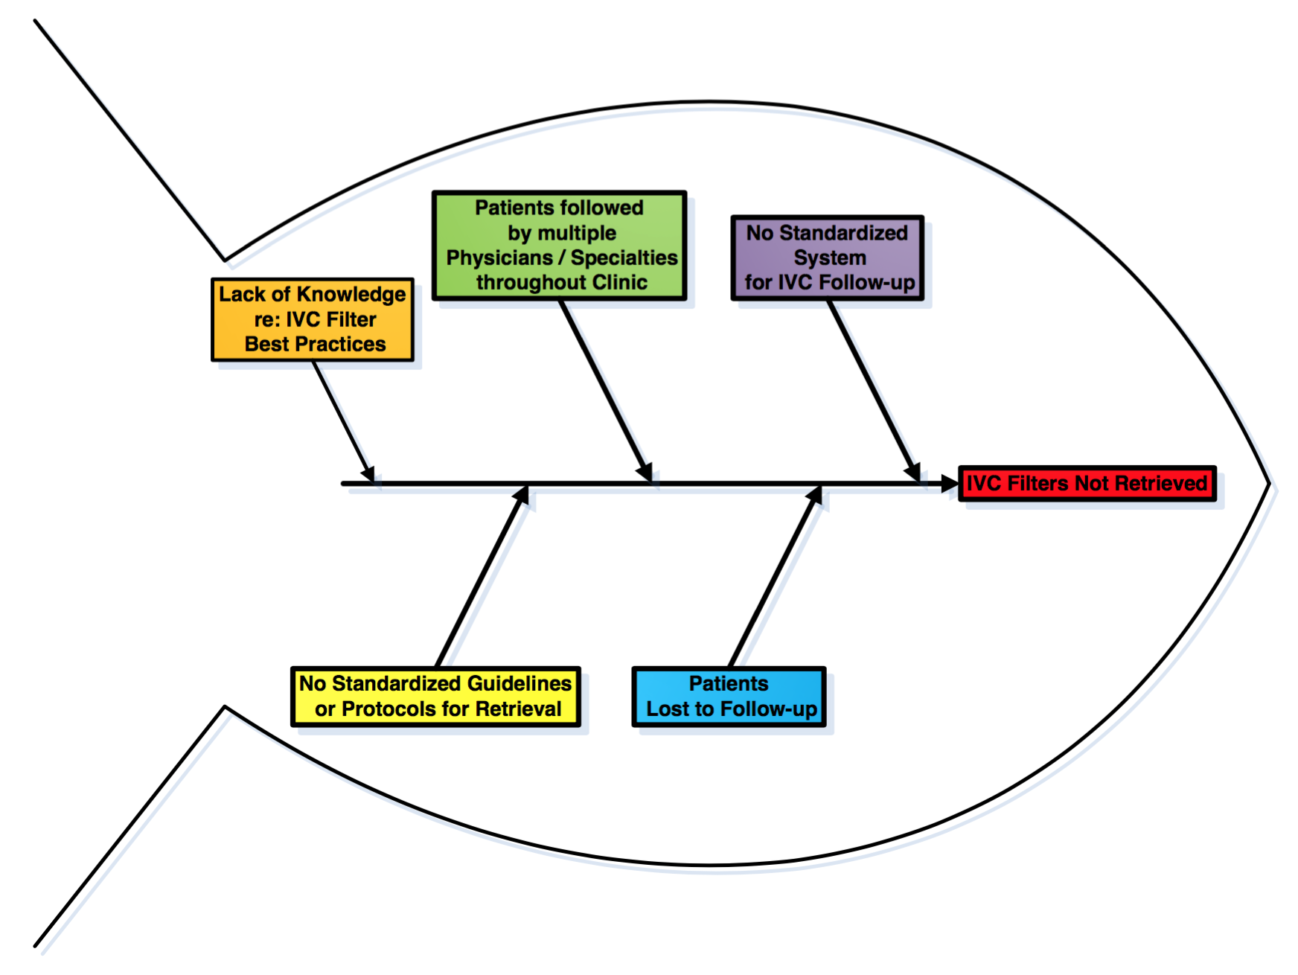
Fishbone Diagram
Workbook, p. 59

Slide 36
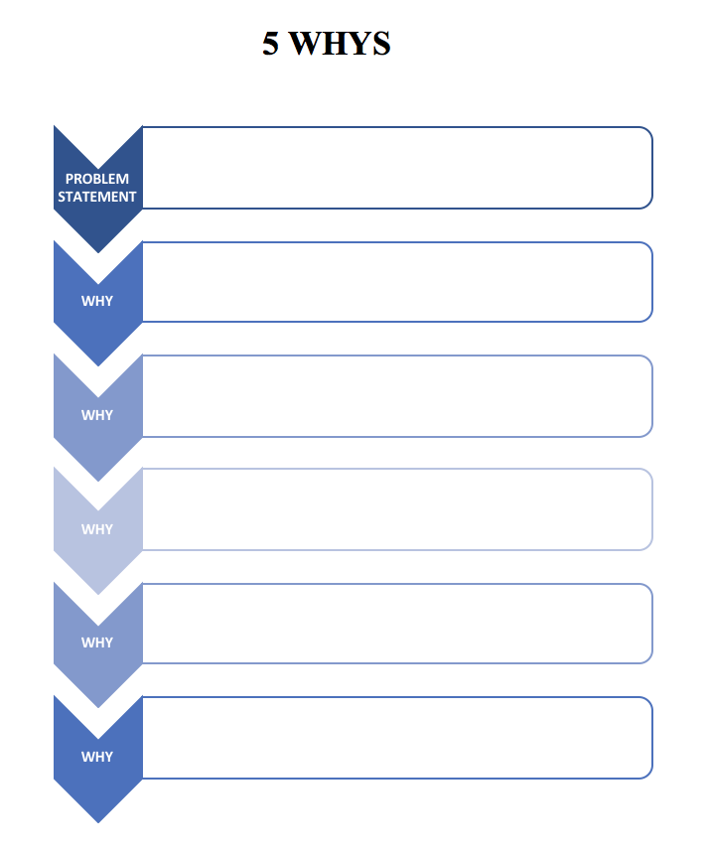
5 Whys
Workbook, p. 57

Slide 37
Project Deliverables
DUE AUG 19
Define/Measure/Analyze
DUE AUG 26 / SEPT 2
Improve
Learning Session 3 SEPT 14-16 to NOV 15
Control
Process mapping (current, updated COVID) Problem Statement Baseline Metric Voice of the customer Analyze tools (5 whys, etc.) Presentation | 5S PDSA Data Collection – After Improvement Presentation | PDSA Standard Work (SOP) Control Plan Final Presentation
DATES NEED TO BE UPDATED

Slide 38
Thank You
Please take the poll!

